Slide 1
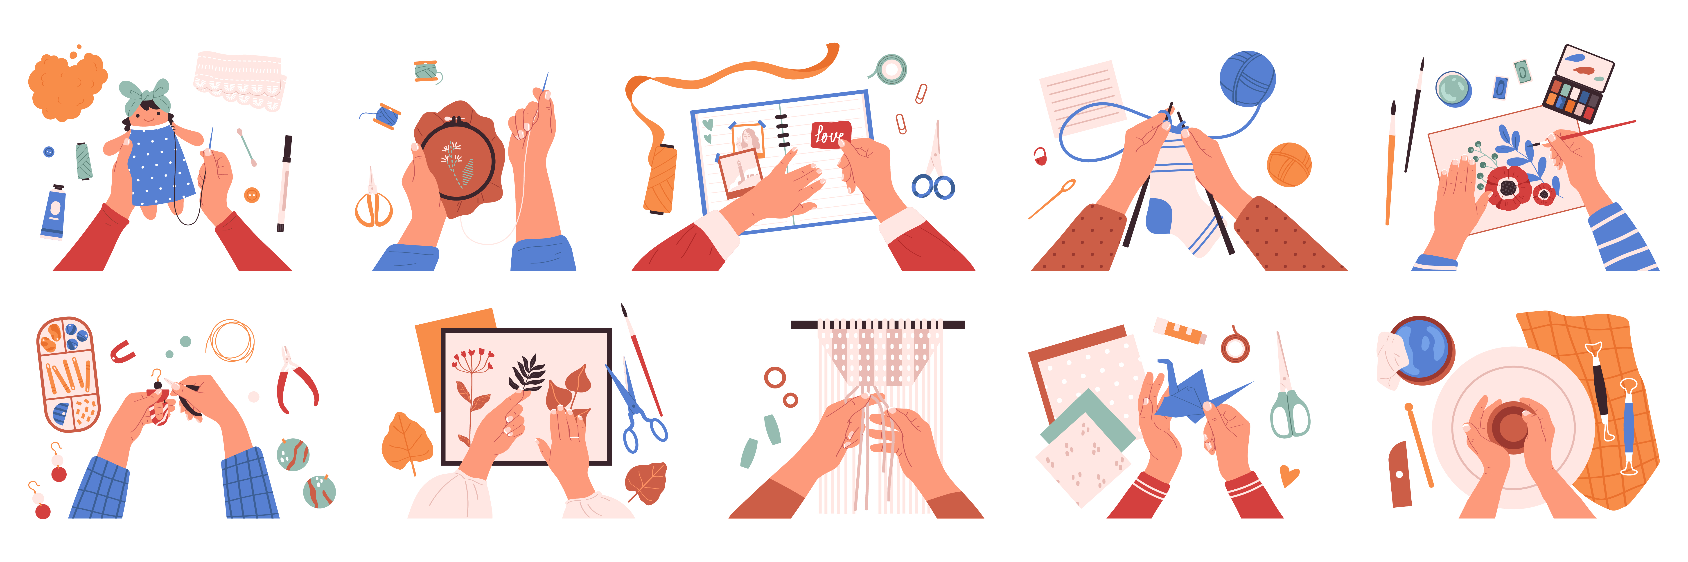
CRAFT

Slide 2

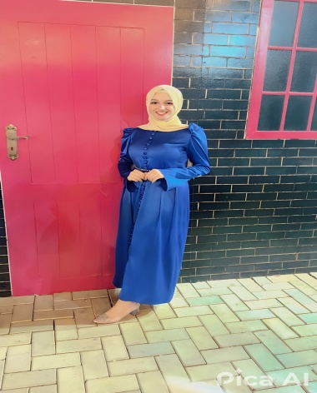

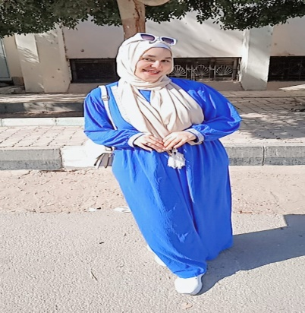
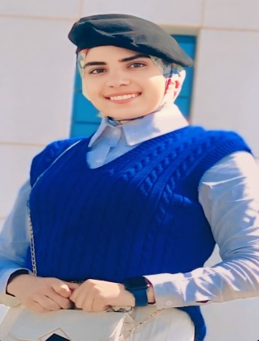
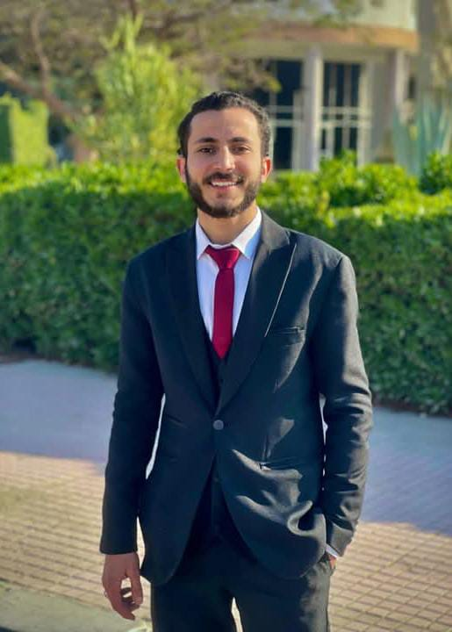
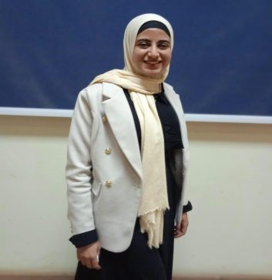
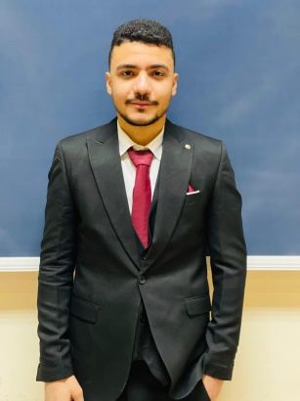
Our Team
Eman Mohamed
Mohamed Ahmed
Hasnaa Abdel Hamid
Youssef Hassan
Eman Ashraf
Supervisor:-
Dr. Manal Shaaban
Eng. Ahmed Gomaa
Nourhn Nady
Mohamed Ahmed

Slide 3

Content
1. Introduction
2. Problem Statement
3.Gathering Requirements
4.Challenges and Problems
5.Challenges Solutions
6.System Analysis
7.Future work
8. Conclusion

Slide 4
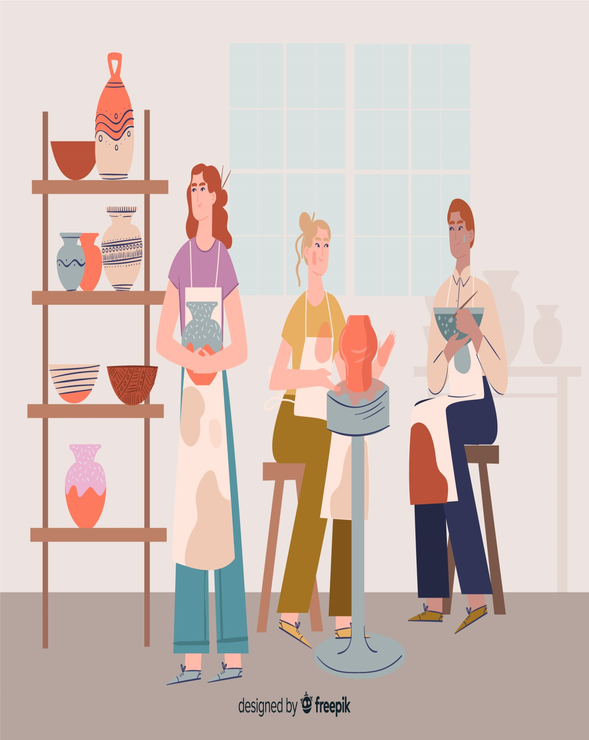
Introduction
Definition: Craft refers to the creation of handmade products using artistic skills and traditional techniques.
Historical Significance: Handicrafts have been an essential part of human culture for centuries, reflecting heritage, traditions, and creativity.
Types of Crafts: Includes pottery, embroidery, woodworking, textile weaving, resin art, candle-making, and more.
Importance: Crafts help preserve cultural identity, promote sustainability, and provide economic opportunities for artisans.
Modern Relevance: With the rise of e-commerce, handmade products are becoming increasingly popular, appealing to customers looking for unique, high-quality, and personalized items.

Slide 5

Problem Statement
1
2
Limited Reach
High Competition
3
4
Lack of Awareness
Loss of Tradition
5
6
Financial Struggles
Technology Challenges

Slide 6
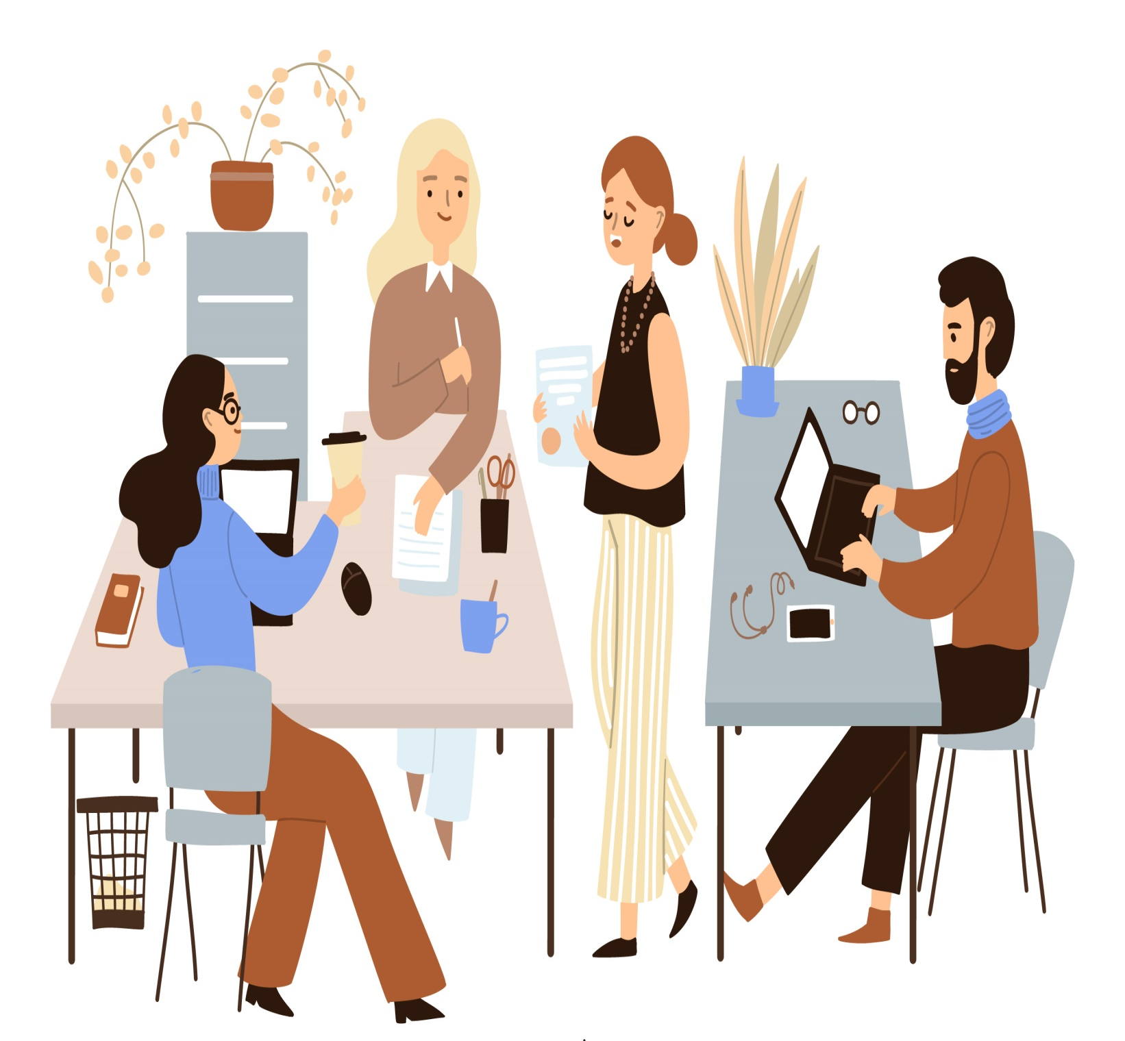
Gathering Requirements
1
Functional Requirement
1
2
User Account Management
Product Management
3
4
Shopping Process
Rating & Review System
5
6
Search & Filtering System
Order Management

Slide 7

Gathering Requirements (Cont.)
2
Non-Functional Requirement
1
2
Performance
Security
3
4
Scalability
Availability & Reliability
5
6
Usability
Compatibility

Slide 8

Challenges and Problems
1
2
Technical challenges
Operational challenges
3
4
Marketing challenges
Financial challenges

Slide 9
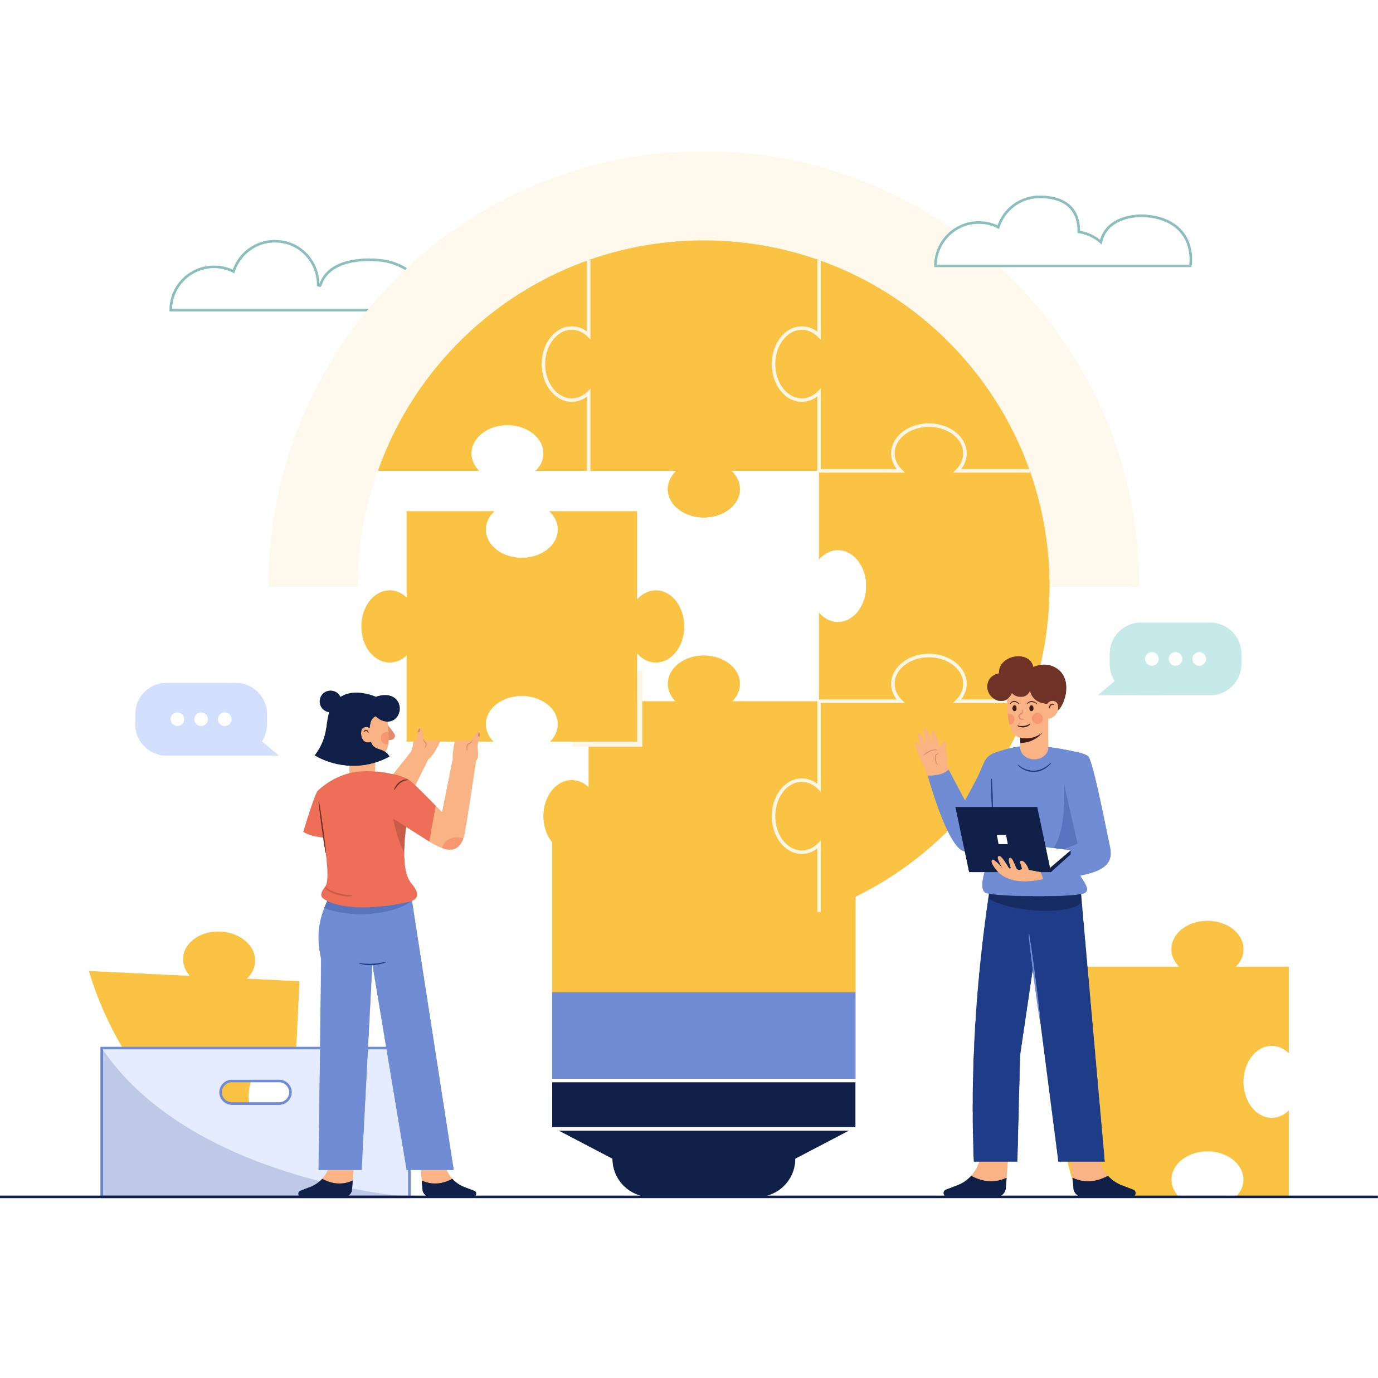
Challenges Solutions
1
2
User-Friendly Online Platform
Training and Workshops
3
4
Marketing Support
Fair Commission System
5
6
Partnerships with NGOs
Cultural Education

Slide 10
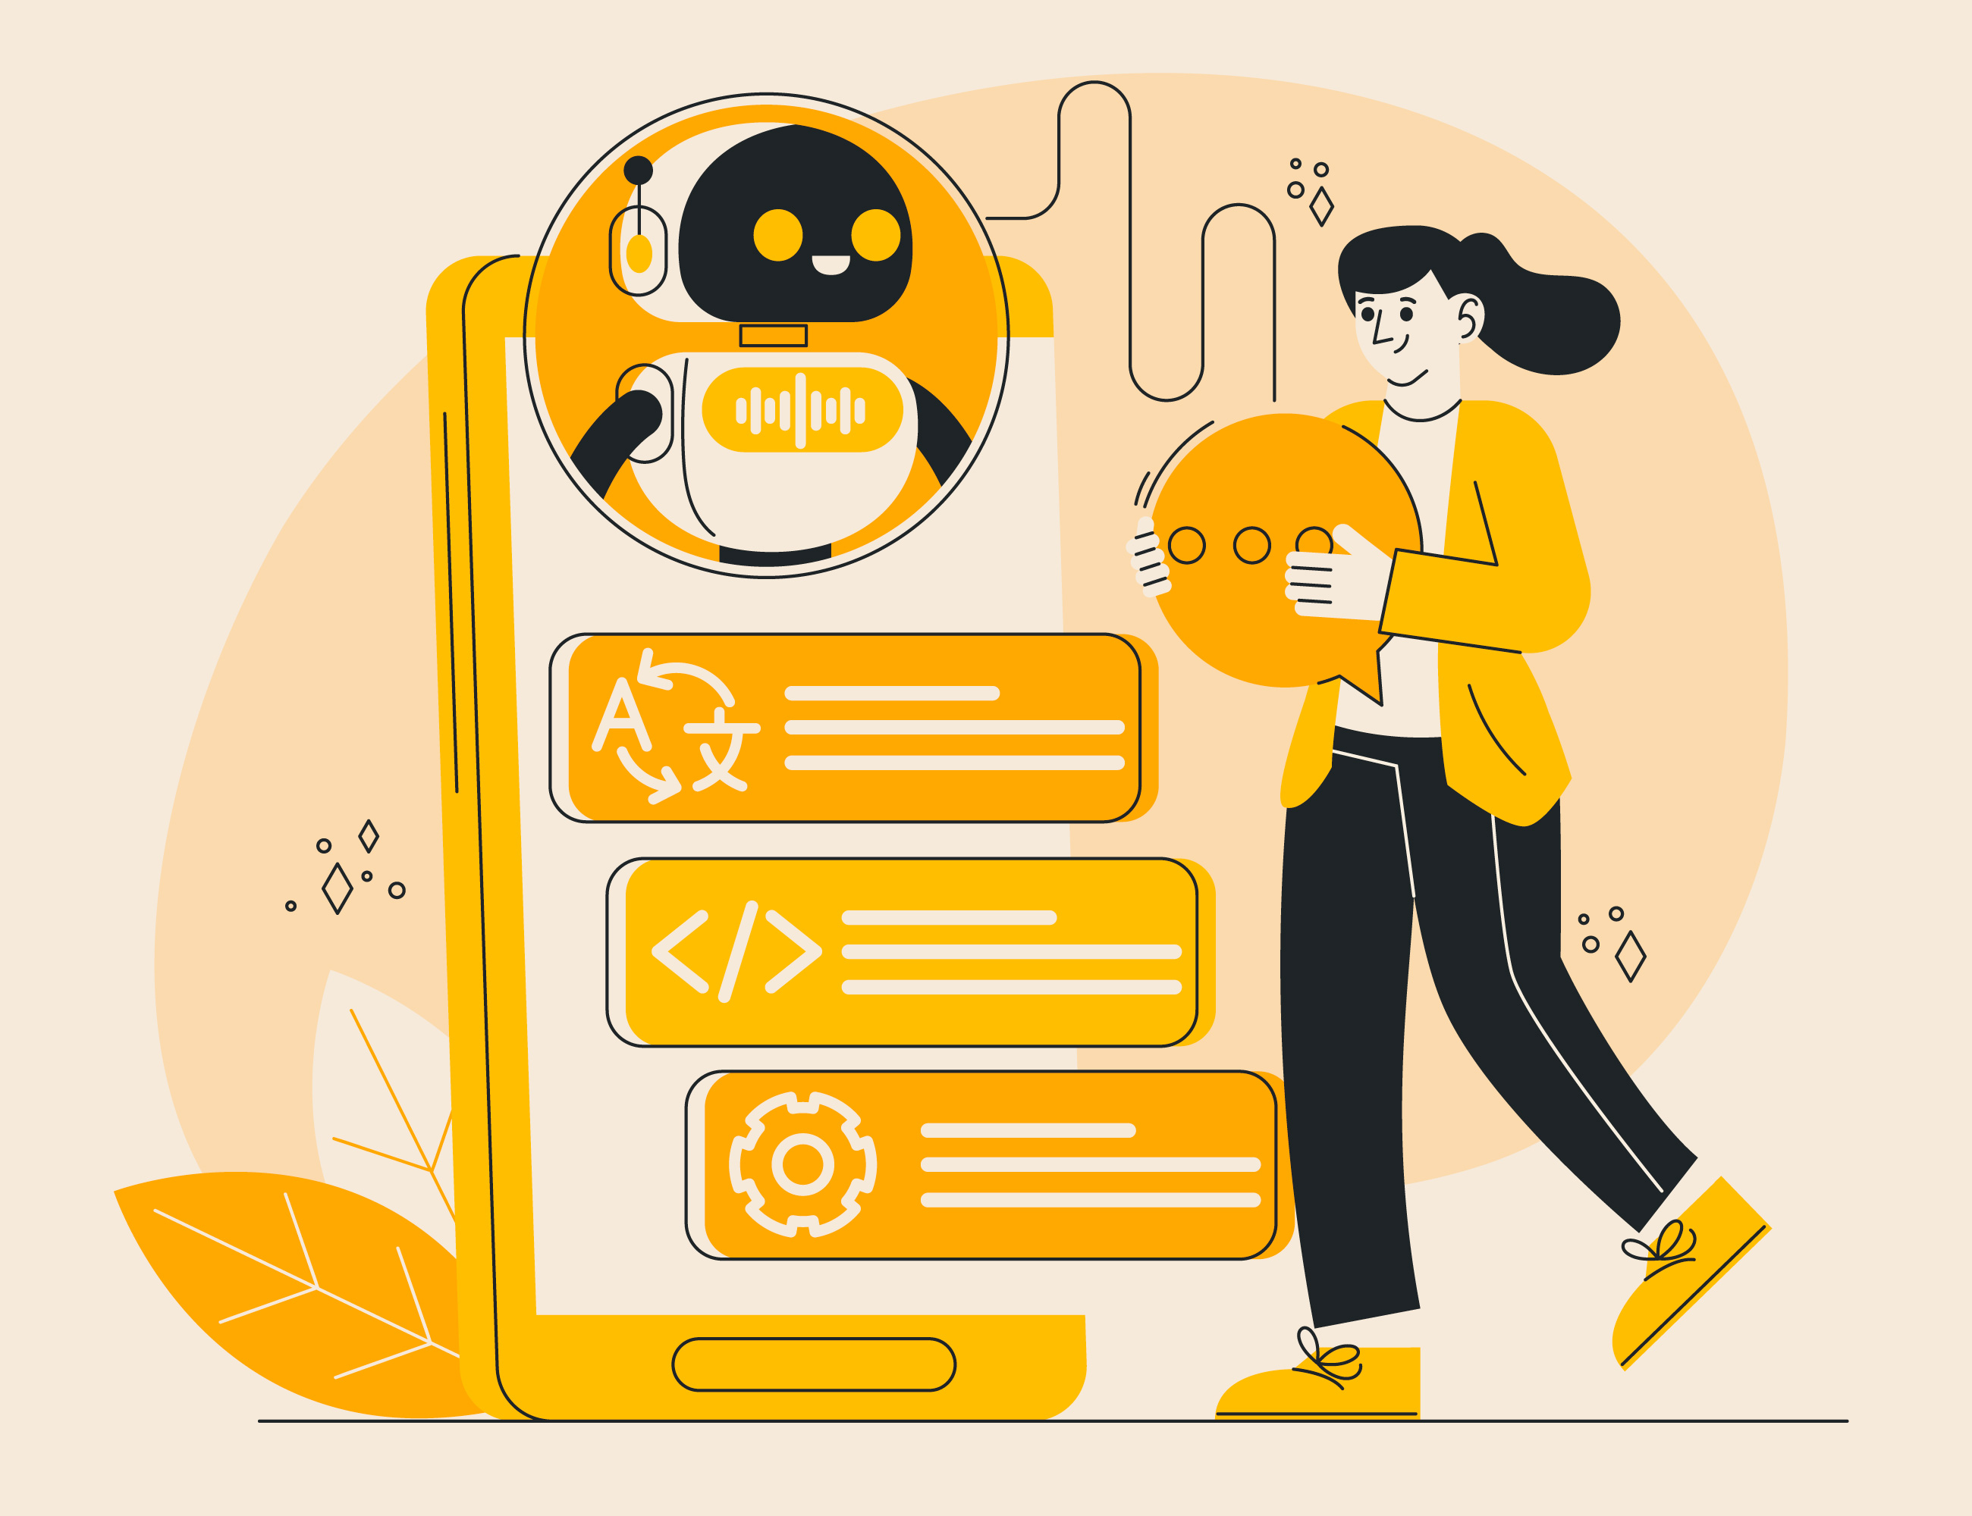




System Analysis
1
Technologies
UI Design: Figma
Front-End: HTML,CSS JavaScript
Back-End: PHP
Database: MySQL

Slide 11
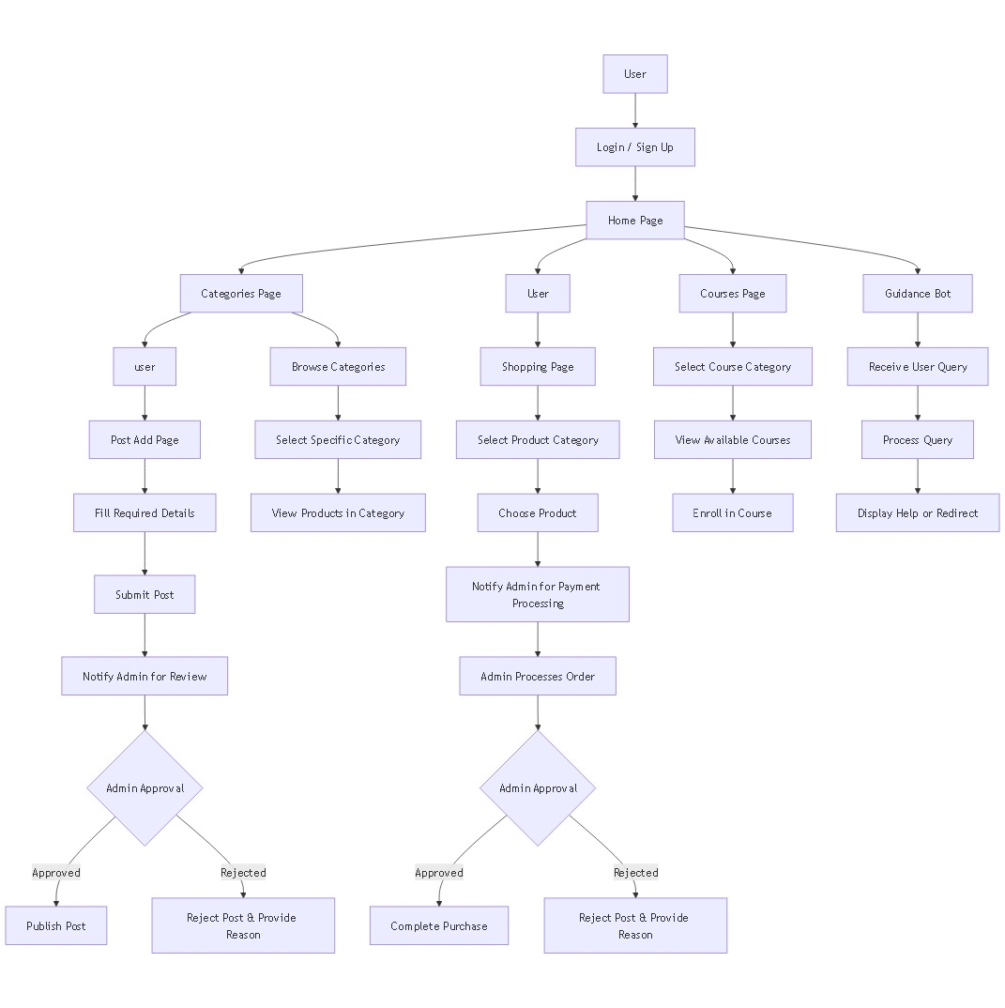
System Analysis (cont.)
2
Tools
1
User Flow Chart

Slide 12
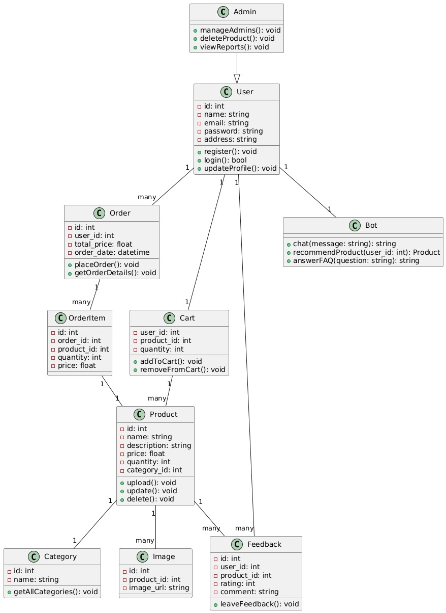
System Analysis (cont.)
2
Tools
2
UML Class Diagram

Slide 13
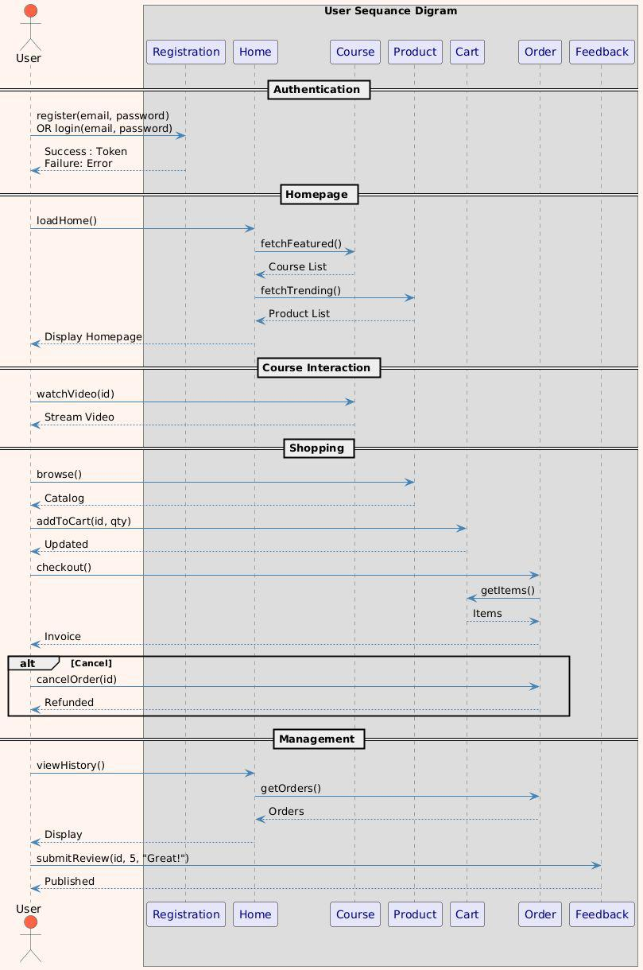
System Analysis (cont.)
2
Tools
3
UML Sequence Diagram “User”

Slide 14
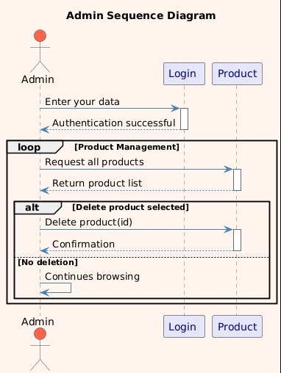
System Analysis (cont.)
2
Tools
3
UML Sequence Diagram “Admin”

Slide 15
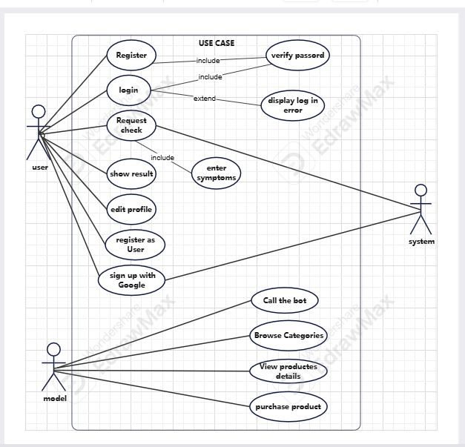
System Analysis (cont.)
2
Tools
4
UML Use Case Diagram

Slide 16
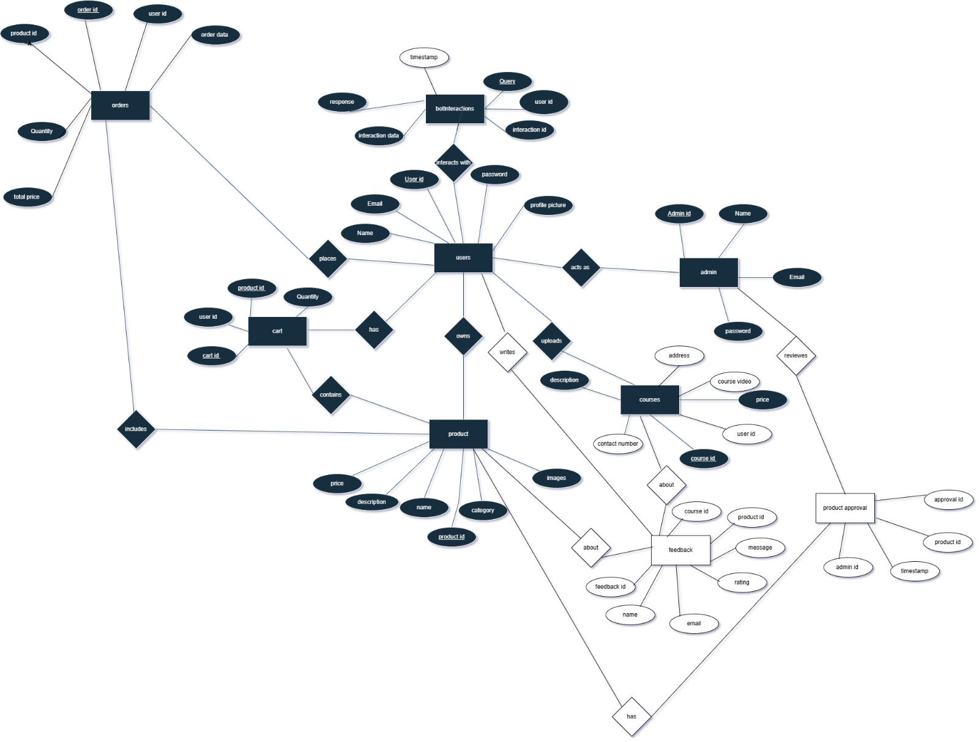
System Analysis (cont.)
2
Tools
Entity Relationship Diagram (ERD)

Slide 17

Future work
1
2
Mobile App Development
AI-Powered Recommendations
3
4
Multilingual Support
Live Craft Workshops
5
6
Advanced Analytics Dashboard
Global Shipping Integration

Slide 18

Conclusion
Craftsmanship is more than a skill; it’s a legacy of history and culture. Yet, modern challenges threaten its survival. Our solution goes beyond commerce, aiming to revive, sustain, and celebrate artisans, ensuring they are valued in the digital era.
Because handmade is not just a product—it’s a story worth preserving.

Slide 19

Thank you for your attention

